Slide 1

Welcome
Global health
Session 6
Dr. Tilly Paz

Slide 2

In this session you will:
Understand the main causes behind some of the most prevalent NCDs (globally) and their effects and burdens
Understand the barriers to tackling those diseases on a global level
Work with case studies of specific countries that tried tackling NCDs

Slide 3
The Importance of Noncommunicable Disease Which one of them is the most important?
Burden of noncommunicable diseases (NCDs) greater than burden of communicable diseases
The burden of NCDs will continue to increase as countries develop economically
The risk factors relate in significant ways to lifestyle, much of which is within people’s control
Often prevented at low cost, but expensive to treat
High direct costs of treatment and even higher Indirect costs from lost productivity

Slide 4
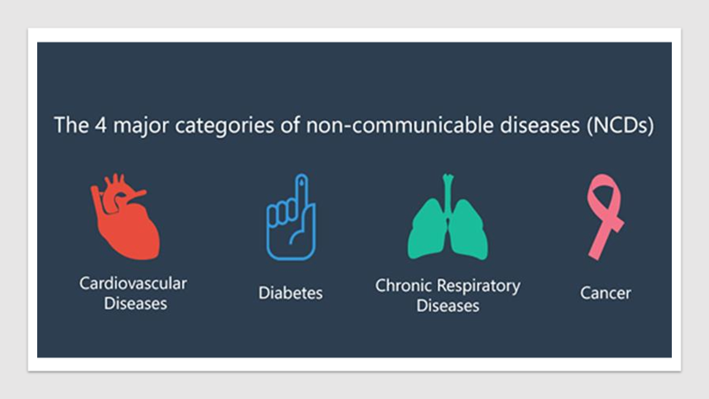
Key Terms and Definitions
Noncommunicable diseases: cannot be spread by an infectious agent, they last a long time, and they are often disabling and lead to death if not treated appropriately
Cardiovascular Disease: disease of the heart or blood vessels. This term encompasses both ischemic heart disease and stroke
Cholesterol: a fatlike substance that is made by the body and is found naturally in animal-based foods such as meat, fish, poultry, and eggs
Diabetes: an illness caused by poor control by the body of blood sugar
Hypertension: high blood pressure, with a reading of 140/90 or greater
Ischemic heart disease: a disturbance of the heart function due to inadequate supply of oxygen to the heart muscle
Stroke: sudden loss of function of the brain due to clotting or hemorrhaging
Other major NCDs: Cancer; Mental disorders; Vision and hearing loss

Slide 5
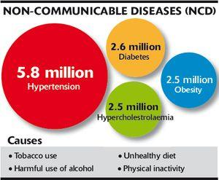
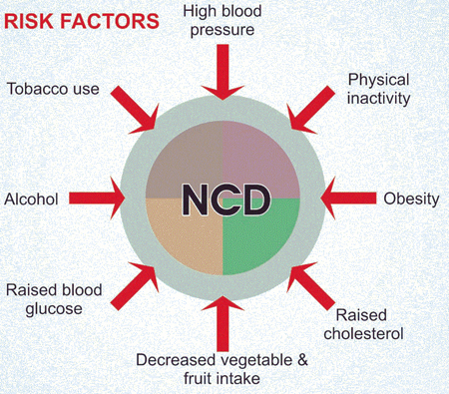
Risk factors for non communicable disease
Lifestyle
Diet
Physical activity
Tobacco use
Alcohol use

Slide 6
Diseases of modernisation and work
As most societies shift from rural agriculturally based economies to urban, service and industrially based, their populations face ailchallenges related to work , transport, stress, toxic exposures and consumption patterns
Agrarian societies also face issues – of use of toxic chemicals, dangerous machinery , reduced health and safety measures to compete on the global market
(Birn, Pillay and Holz 2017 p. 257)

Slide 7
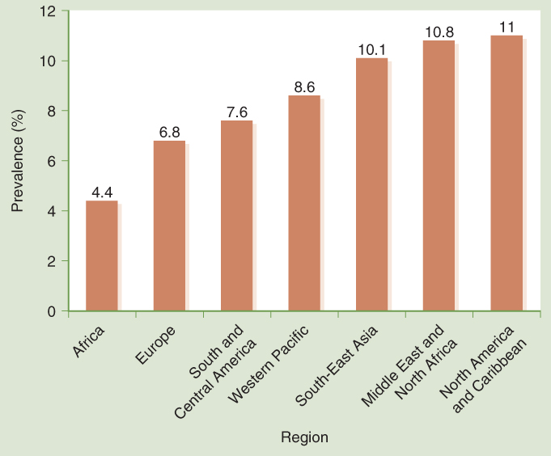
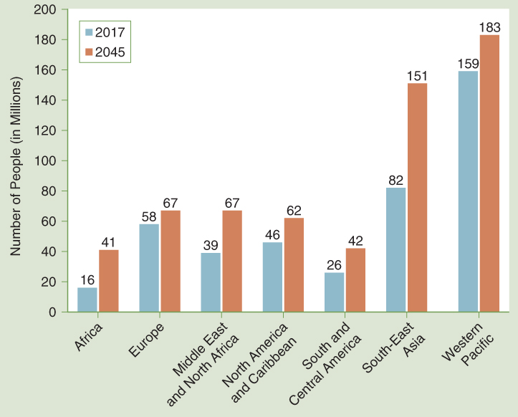
The Burden of Noncommunicable Diseases, Diabetes as an example
Data from International Diabetes Federation. (2017). IDF diabetes atlas (8th ed.). Retrieved from http://www.diabetesatlas.org/IDF_Diabetes_Atlas_8e_interactive_EN/

Slide 8
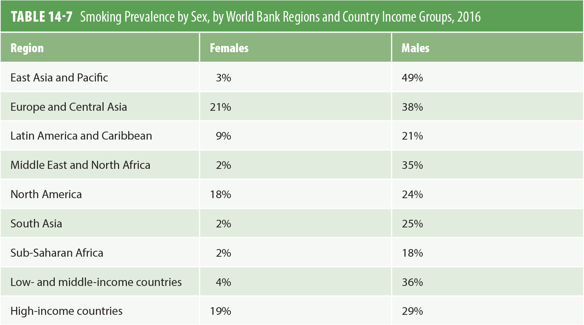
The Burden of Noncommunicable Disease: Tobacco
Data from The World Bank. (n.d.). Data: Smoking prevalence, females (% of adults). Retrieved from https://data.worldbank.org/indicator/SH.PRV.SMOK.FE; The World Bank. (n.d.). Data: Smoking prevalence, males (% of adults). Retrieved from https://data.worldbank.org/indicator/SH.PRV.SMOK.MA

Slide 9
Addressing the Burden of Noncommunicable Diseases Think – why is it not working with alcohol use?
Tobacco Use
The Framework Convention on Tobacco (2003)
Taxing cigarettes at higher rates would be effective for reducing consumption
Legal restrictions on smoking
Ban on cigarette advertising
Biggest impact in high-income settings has come from comprehensive control programs
Notes:
Alcohol is mainly about tax and early closures (people can keep drinking outside and at home)

Slide 10
Addressing the Burden of Noncommunicable Disease Think – what differences do you see between tobacco use and mental health policies?
Mental Health
WHO recommends that countries:
Have a mental health policy and ensure there is a unit of government responsible for mental health
Budget for mental health programs
Train primary healthcare workers in mental health
Integrate mental health into the primary healthcare program
Notes:
The root is stress, yet policies don’t touch that, only the symptom

Slide 11
Future Challenges of NCDs on GH
Incidence
Number of new cases of noncommunicable disease will grow because of aging, urbanization, globalization, and lifestyle changes
Prevalence
Number of people with disease will also rise because the diseases are chronic, and we also live longer
Burden
Low-income countries will have to deal with communicable and noncommunicable disease simultaneously

Slide 12
Understanding NCDs through a critical academic paper
In your groups, divide the work and prepare for a critical discussion in the class.
One of you will read the paper to the group (slowly!), while the others will stop the reader whenever an important fact/idea/critical thought is presented.
Create a dictionary with important or unfamiliar terms (find out what they mean!)
Take notes of the various main facts
Phrase the main arguments with the depth of a year 3 cohort…

Slide 13
Main messages and key points

Slide 14
Main messages and key points

Slide 15
Selected diseases and their burden

Slide 16

Breast and cervical cancer
2012- 1.7 million were diagnosed with breast cancer globally
528,000 new cases of cervical cancer each year
Effects of cervical cancer are most notable in sub –Saharan Africa and 70% of the global burden of cervical cancer falls in low and middle income countries
Skolnik (2016 p. 374)
Notes:
20% increase in breast cancer incidence rate since 2008

Slide 17

Global burden of cancer
Growing due to increased life expectancy and decrease in communicable diseases
Types of cancer most prevalence in a region can depend on environmental factors and standard of living.
Worldwide trends show that in low and middle income countries the shift towards high income country lifestyles leads to a rising burden of cancers associated with reproductive, dietary and hormonal risk factors
Skolnik ( 2016 p. 374)
Notes:
As income levels rise , cancers for sedentary behaviour or high fat consumption is a risk factor which tends to increase as a proportion of all cancers
Increases in breast cancer in low income countries will largely be due to changes in reproductive practices with women choosing to have fewer children have their first pregnancy later in life and breastfeed for a shorter period
Incidence rates are highest in high income regions due to average longer life spans
Mortality much higher in lower and middle income developed countries – due to poor early detection and access to treatment facilities
Skolnik (2016 p. 374)

Slide 18

Cancer
Increase in numbers of cancers in middle income countries
Advances in screening, detection, treatment and prevention recently however access to treatment varies greatly between developed and less developed countries
McCracken and Phillips (2012)
Boyle P and Levin B(2008)Worldwide Cancer Report. WHO, Geneva.
Notes:
Risks of cancer increase with age
Cancer has a higher incidence in older individuals above 65 years due to more prolong exposure to environmental risk factors and accumulation of genetic change
Distinctive lifestyle and diet associations
WHO estimate that 40% of all cancers could be prevented by changes in lifestyle and improved prevention and screening
McCracken and Phillips (2012) Jacobsen (2014) Skolnik (2016 p. 374)

Slide 19
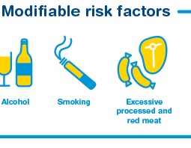
Risk factors for cancer
Associations with tobacco use – lung and oesophageal cancers
Using tobacco can increase the risk of other cancers such as prostate and breast cancers
Alcohol is associated with liver, upper digestive tract, breast and colorectal cancers
Diets high in red and processed meats and low in fibre – associated with colorectal cancer
Skolnik (2016 p. 374)
Notes:
Obesity is a risk factor for breast cancer ( Post menopausal) colorectal , endometrium , kidney, esophageal and pancreatic cancers
Low physical activity can be a major risk factor for colon breast and endometrial cancers
Skolnik ( 2016 p. 375)
Cancer is a unique challenge as there are many forms of cancer and they may have different characteristics in how they affect different people, their risk factors and how they can be prevented and treated.
Skolnik (2016 pps 371-372) Jacobsen (2014 pps 142-143)

Slide 20
Mental health
Long been under-emphasised part of global health
Framed by discrimination and stigma
Concentration of mental illness in poor and socially excluded populations
Challenges in measurement and treatment
1 in 4 people estimated to experience a mental health problem in their lifetime
(Birn, Pillay and Holz 2017 pp. 239-240)

Slide 21
Mental health
Worldwide 350 million – suffer from depression
21 million – shizophrenia ( WHO 2016)
40 million from drug use disorders
Accompanying and contributing to this distress an overwhelming majority of people with mental and psychosocial disabilities are living in poverty, poor physical health and are subject to human rights violations ( WHO 2015)
(Birn, Pillay and Holz 2017 pp. 239-240)

Slide 22

Mental health
Suicide often accompanies other NCDs
Higher suicide numbers in LMICs
Women attempt suicide more than men but men’s completed suicide rates are 3 times higher in HICS and 1.5 times higher in LMICS
Mental health disorders interlinked with substance misuse disorders but lack integrated counselling services
High levels of mental illness in prison inmates
(Birn, Pillay and Holz 2017 pp. 239-240)

Slide 23
Mental health
Mental health especially schizophrenia is disproportionately borne by the poor and oppressed
Accumulated lifelong stressors such as precarious living and working conditions , social isolation, exploitation, mistreatment and lack of health care and social support lead to distress consistent with depression
Higher rates of mental disorders among women and sexual minorities reflect discrimination, disenfranchisement , gender oppression and poverty in both HICS and LMICs
It is estimated that over ¾ of persons with serious mental health illness in LMICs do not receive treatment with as little as 0.20 $ spent on care in LMICs compared to $45 in HICs
In LMICs only institutionally based services are available and social support for family and care givers is inadequate
(Birn, Pillay and Holz 2017 pp. 239-240)

Slide 24
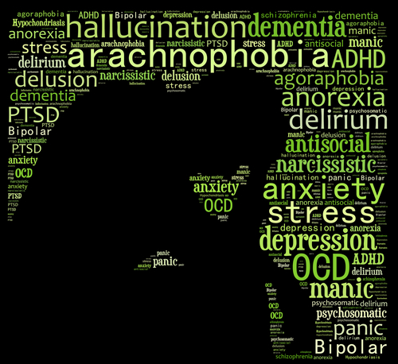
Mental health
Clearly unmet mental health needs in LMICs
Dominant biomedical approach of the global health movement and its emphasis on scaling up of treatment interventions despite contextual , cultural and ideological differences has met with criticism
Global mental health movement has been accused of medical imperialism and may inappropriately impose Western models of psychiatry in LMICs Watters (2010) cited in Birn,Pillay and Holz (2017)
Compounded by powerful pharmaceutical industry and pursuit of new markets and profits
(Birn, Pillay and Holz 2017 pp. 239-240)

Slide 25

Addressing the burden of NCDs-Mental disorders
WHO recommends a number of steps to address mental health issues;
Having a mental health policy
Ensuring there is a unit of government responsible for mental health
Skolnik (2016 p. 387)

Slide 26

Addressing the burden of NCDs-Mental disorders
Budgeting for mental health programs – including programme development, training , drug procurement and program monitoring
Training primary healthcare workers in mental health
Integrating mental health into the primary healthcare program
Skolnik (2016 p. 387)

Slide 27
Addressing the burden of NCDs – mental disorders
WHO recommendations as part of its Mental Health gap action program
Package of mental health interventions should be available in each country tailored to the burden of disease

Slide 28

Tobacco use
Globally and for all ages and both sexes, tobacco is the 3rd leading attributable risk factor for death
Tobacco is also the 3rd leading risk factor for death in low and middle incomes countries and in high income countries
It is estimated that 5 million deaths annually are associated with the use of tobacco of which about half are in low income countries
Skolnik (2016 p. 376)
Notes:
IT is also estimated that 1 in 5 males over 30 and 1 in 20 females over 30 who die worldwide die of tobacco related deaths
Ultimately one half to 2/3 of those who smoke will die of causes related to tobacco
In addition half of all tobacco related deaths occur among people ages 35-69
It is estimated that about 1.5 billion people smoke worldwide
In all regions of the world men smoke more than women do
Smoking varies by sex and also socio-economic status and level of educational attainment
The higher the socio-economic status and the higher the level of education, the less likely a person is to smoke
Skolnik (2016 p. 378)

Slide 29

Alcohol
Alcohol is a major public health problem
Alcohol use disorders constitute an important burden of disease making up about 0.7 % of all DALYs globally
Alcohol use disorders are the 9th leading attributable risk factor for deaths globally
9th leading risk factor in low and middle income countries
6th leading risk factor in high income countries
Skolnik (2016 p. 378)
Notes:
Prevalence of high risk drinking varies by region
Estimated that men in Europe and Central Asia have the highest rates of high risk drinking
21% between ages 45-59
Prevalence of high risk drinking also varies by age with fewer people engaging in high risk drinking after age 60
Skolnik (2016 p. 378)

Slide 30
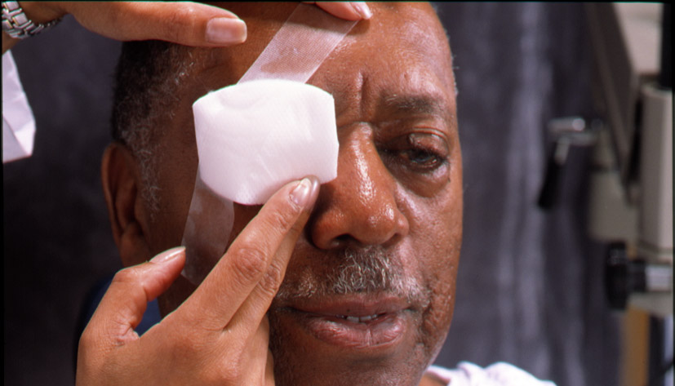
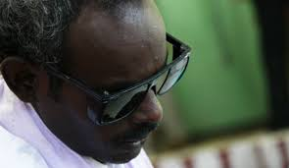
Vision loss
Globally aging and continued improvements in life expectancy will increase the burden of vision and hearing loss as causes of the burden of disease
Major reasons for vision loss are refractive disorders
Leading cause of blindness is unoperated cataracts
Blindness can also be cause by glaucoma, Vit A deficiency and rubella
Some blindness also has parasitic and infectious causes – eg trachoma and onchocerciasis
Skolnik (2016 p. 376)
Notes:
WHO estimates that 285 million people were visually impaired in 2014
39 million were blind and 246 million had low vision
90% of those who suffer visual impairment live in low and middle income countries
Poverty
Gender
Age
Lack of access to health services
Cigarette smoking – risk factor for cataracts and glaucoma
Women disproportionately affected by visual impairment
Skolnik (2016 p. 376)
Skolnik (2016 p. 376)

Slide 31


Hearing loss
WHO estimates 2014 -360 million people in the world had hearing loss that was disabling
Equal to about 5% of the world’s population -328 million adults and 32 million children
80% of them had adult onset hearing loss and about 20% had childhood onset hearing loss
About 1/3 of people over 65 years are affected by disabling hearing loss
Skolnik (2016 p. 377)
Notes:
More males have suffered hearing loss than females – probably as result to exposure to noise
Global burden of disease (2010) indicated that 0.64% of DALYs globally could be attributed to deafness and hearing loss
Childhood onset hearing loss is related to congenital conditions, ear infections or complications of other diseases such as meningitis
Adult onset hearing loss is related to exposure to noise and chemicals as well as to aging
Skolnik (2016 p. 377)

Slide 32
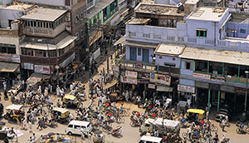
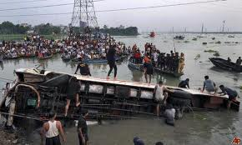
Injuries, accidents and road traffic accidents
Injuries and accidents are a growing cause of mortality and long-term disability particularly in developing countries
Injuries cause 12% of global burden of disease
3rd leading cause of overall mortality
Especially prevalent in middle income countries
Male injury mortality is twice the rate of females
McCracken and Phillips (2012) Jacobsen (2014)
Notes:
Large numbers of people living near poorly regulated industrial areas at risk of industrial and environmental accidents
Road traffic injuries major but neglected challenge for public health especially in low and middle income countries due to poorer road conditions, poorer regulation and training systems
McCracken and Phillips (2012 pps 175-177)

Slide 33
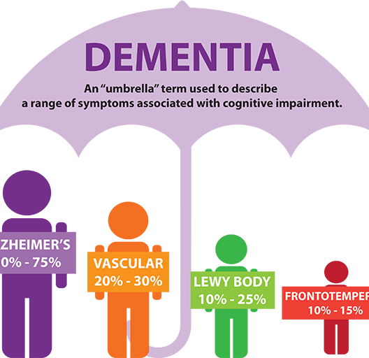
Dementias
More than 25 million adults worldwide have dementia and this will increase significantly in the coming decades
Predicted at 65.7 million in 2030 and 115.4 million in 2050
Dementias – one of the growing major health challenges
4.1% of total disease burden among people over 60
McCracken and Phillips (2012) Jacobsen (2014)
Notes:
11.3% of years of years lived with a disability
2nd most burdensome chronic condition – of NCDS accounting for 11.9% of years lived with disability and 1.1 % years lost
Mcracken and Phillips (2012 pps 184-185) Jacobsen (2014 pps 153-154 )
Difficulties with estimated figures are exacerbated by difficulties with diagnosis and often resistance to acknowledge condition
Data is often unreliable in poorer countries
These figures don’t include numbers of people affected by the condition ie impact on carers and family
Dementia sufferers are increasingly less able to manage daily living activities ( Instrumental activities of daily living (IADLs)
McCracken and Phillips (2012 pps 184-185)

Slide 34
Addressing the burden of NCDs
UN convened a high level meeting on NCDs in September 2011
Resulted in an international political commitment to trying to reduce the burden of NCDs by 25% by the year 2025
Meeting highlighted the idea that all countries including today’s low and middle income countries must take measures to reduce the burden of non-communicable disease
2017- WHO – setting up a high level commission on NCDs
http://www.who.int/mediacentre/news/statements/2017/ncd-commission/en/
Skolnik (2016 p. 381)
Notes:
Final declaration of the meeting indicated a number of steps countries could take to address their burden of NCDs
Focus on prevention and the main risk factors of tobacco, alcohol, dietary risks and the lack of physical activity
Increasing funding to address NCDs
Declaration further noted that countries should;
Take multi-sectoral, cost effective approaches to addressing NCDs
Speed action on the measures indicated in the Framework Convention on Tobacco
Implement WHO recommended approaches to diet, physical activity, alcohol and the marketing of unhealthy foods to children
Skolnik (2016 p. 381)

Slide 35
Addressing the burden of NCDs
Promote cost effective measures to reduce salt, sugar and saturated fats in food and eliminate trans fats in food
Promote vaccination against the infectious causes of NCDs such as the vaccines against Hepatitis B and HPV virus
Measures should be taken to strengthen the ability of health systems to monitor NCDs and to act on them effectively
Enhancing universal health coverage and improving access to affordable medicines
Skolnik (2016 p. 381)
Notes:
International Action Group on NCDs – group suggested countries should take action immediately on;
Tobacco – accelerate the implementation of the Framework Convention on Tobacco Control
Salt: promote greater awareness and voluntary action by the food industry to reduce salt consumption
Obesity, unhealthy diet and physical inactivity – promote greater knowledge and take measures on taxes, food labelling, food subsidies and food marketing to reduce overconsumption and the consumption of unhealthy fats and to encourage greater consumption of fresh fruits and vegetables and of physical activity
Skolnik (2016 p. 381)

Slide 36
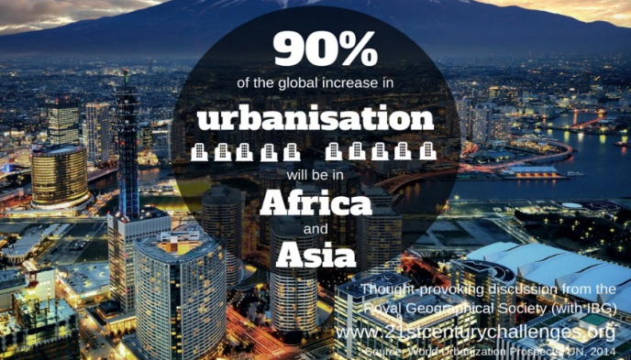
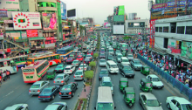
Addressing the burden of NCDs – High blood pressures , high cholesterol and obesity
Urbanisation, motorisation and TV all reduce physical activity
Countries can use public policies to try and limit the role of automobiles, promote walking and biking and design communities in ways that encourage healthy lifestyles
Eg Singapore and London taxes are levied on cars that enter the centre of the city to reduce the use of vehicles and their attendant traffic and pollution
Skolnik (2016 p. 385)

Slide 37

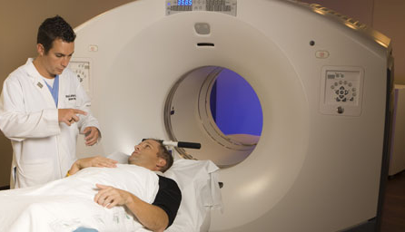
Addressing the burden of NCDs- Cancer
Tobacco control is overwhelmingly first priority for preventing cancer
Prevention is the most cost effective method to reduce the economic burden of cancer because cancer treatment can require very advanced and expensive intervention over a long period of time
Skolnik (2016 p. 386)
Notes:
Countries can also try to reduce the burden of cancer by addressing infectious agents that are associated with cancers
In addition to preventive measures improved early detection methods are also critical to reducing the global burden of cancer
The world must continue to devise low cost effective screening tests for detecting cancer in low resource settings
Treatment programs require greater monetary investment but are necessary to reduce overall cancer burden
There are countries that currently lack any radiation facilities and there are overwhelming shortages of radiation technicians and trained oncologists
There is evidence that even in low income sub Saharan African Countries which has some of the greatest resource deficiencies, can acquire and maintain radiation facilities, although ensuring access for patients from remote rural areas may be difficult.
After radiation facilities countries should focus on developing resources for treatments that require sophisticated pathology and laboratory facilities
Skolnik ( 2016 p 386)

Slide 38
Addressing the burden of NCDs-Mental disorders
Despite the growing importance of mental health disorders – there is often inadequate understanding of the importance of mental health
Lack of funds for mental health
Shortage of funds for mental health, poor understanding of mental health issues and stigma around mental health issues
Notes:
Important burden of disease associated with mental disorders
Low level of development of mental health services in most low income and many middle income countries
WHO recommends a number of steps to address mental health issues;
Having a mental health policy
Ensuring there is a unit of government responsible for mental health
Budgeting for mental health programs – including programme development, training , drug procurement and program monitoring
Training primary healthcare workers in mental health
Integrating mental health into the primary healthcare program
Skolnik (2016 p. 387)

Slide 39
Addressing the burden of NCDs – mental disorders
A significant amount of mental health in low and middle income countries is offered in large psychiatric hospitals – consumes large amount of mental health budget
Evidence shows that for $2-$4 per person per year - Countries could provide more community based approaches to care that would offer drug therapy combined with psychosocial support for bipolar disorder, depression and schizophrenia
Skolnik (2016 p. 387)
Notes:
The goal would be to integrate such support into routine primary healthcare services as far as possible
Childhood mental disorders – prevent such disorders as far as possible – partly through better maternal nutrition and care and treat children pharmacologically as appropriate and offer them psychosocial support
Schizophrenia and other psychotic disorders – Treat with antipsychotic medicines and family or community based psychosocial support

Slide 40
Working with case studies of NCDs
In your group – divide the brief and answer these questions
1) What are the specific problems of the country in regards to NCDs?
2) What is the local context? What makes the place special and different from other countries?
3) What is the regional or global context?
4) What has been done?
5) Which SDGs are relevant and how?
6) Which lessons could be learned? What worked?

Slide 41
Bibliography
Alwan, A., and Mclean D.R., (2009) ‘ A review of non-communicable disease in low and middle income countries’, International health 1 (1) pp.3-9
Birn, A.E, Pillay, Y and Holz, TH (2017) Textbook of Global health. 4th ed. Oxford: Oxford University Press
Holz, C (2017) Global Health Care – Issues and Policies. Burlington, MA: Jones and Bartlett
Jacobsen, K ( 2014) Introduction to Global Health (2nd ed). Burlington,MA. : Jones and Bartlett Learning.
McCracken, K., and Phillips D.R., (2012) Global Health : An Introduction to current and future trends. Oxon: Routledge
Skolnik, R ( 2016) Global health 101 ( 3rd Ed) . Burlington, MA: Jones and Bartlett Learning .
Walls, H and Pearce, N ( 2015) ‘Globalisation and non communicable diseases’ in Hanefield, J (2015) Globalisation and Health (2nded) Maidenhead: Open University/ McGraw Hill

Slide 42

See you next week
13-15
Prepare for the discussion
Bring your printed essay plan, ready for reflection and submission

